Slide 1
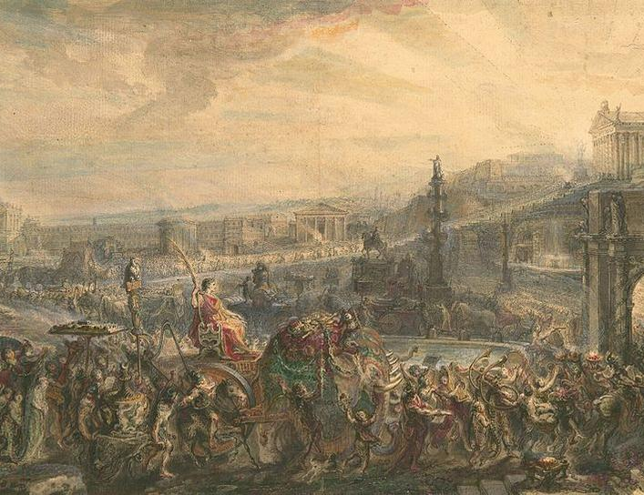
Political Structure
LEARNING INTENTIONS:
- Describe the political structure of Rome
Week 5 Lesson 3
Ms Barrie

Slide 2
When the last king of Rome was expelled in 509 BCE, a constitution was developed that aimed to represent the unified and independent mindset of the new Republic. As the system developed in the centuries following 509 BCE, the constitution created new institutions so that the Republic would fulfill the driving concept of Senatus Populusque Romanus or ‘SPQR’ – The Senate and People of Rome. The people would work with the Senate through various elected magistracies and assemblies to collectively govern Rome. Power would be invested in the hands of many, not few or one. After their experiences of being ruled by a monarchy, Romans feared the threat that overwhelming power vested in one person, such as a king, presented.

Slide 3
The Magistracies
Various magistracies (or political positions) were responsible for ensuring the effective day-to-day running of the Republic.
The cursus honorum provided the structural framework for these positions.
All positions were re-elected annually with the exception of censor (18 months) and dictator (a position only created and filled in times of crisis for a maximum of six months).
Minimum ages and levels of prior military or legal experience were also set to ensure that those holding such positions had the capability to do what the job required

Slide 4
ACTIVITY – Political Structure
Get an A4 Blank piece of paper
Together as a class, we will draw and label the political structure of Rome

Slide 5
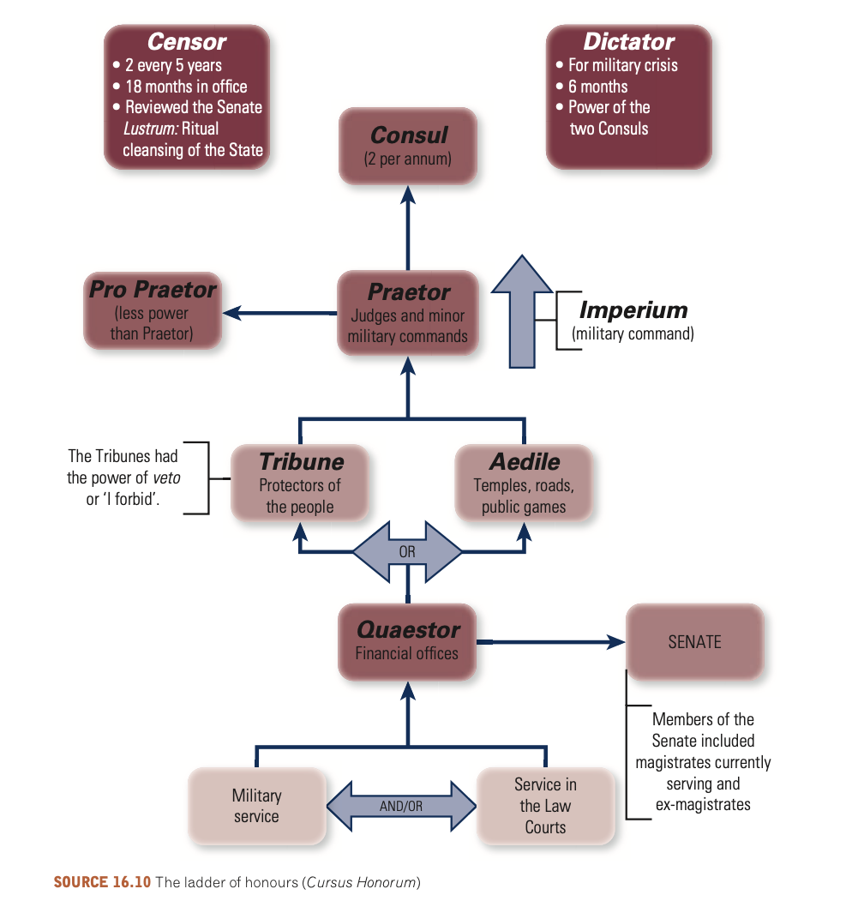

Slide 6
ACTIVITY – Info Sheet
Read through the information sheet as a class
Answer the questions in your book

